Slide 1

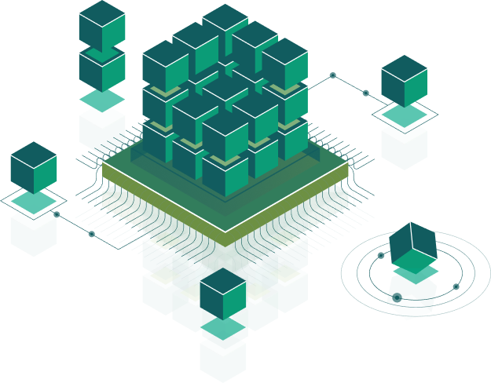
CI/CD, Performance, Production build(Frontend)
Speaker:
Taras Aftanashchuk
Notes:
Introduce course and speacers

Slide 2

How we works
Develop
Build
Delivery
agile, scram,...
local build or continuous integration
local build or continuous delivery
Testing and testing

Slide 3
Production build
Minification
Obfuscation
Notes:
O="content[_ng-%COMP%]ect functioreturn-wrap .%20erasksp n(t){Obj(thismenro}.tu.ptot,null=e(),on_handlecolor:requi.a)(argpx should-fieldype.var jinsiti:r;bordtatusightc.f),elative{m>�->utsred%22 ^ be �S�Code n(){seaskadackgunPvid},n~ft-ssitsh�ow:0ox-� 0:{�:5.4app(t;outl�elength.call 1@ ,i.or.pipe(*�n.ed,�.po��}�ic-r�ius:y(,�)focus%3D�f6f.` sewidth:00p�Id12.es�cripti�arch`ri��yErr%2F@;-webk�-r�:15@Lo��g:nepac},getItemb�d-p�d�gObjtop@ �sp�l�l}.ta8a8p�sut�R�pse.web�k-moz-;b�d(n,ledow�Jsassign#�6f8f�(P�s})=�.�||,e=1,o,[]17.6tifan��n�=�.e<o;e+�;�+_�e�:0ar�)�r � �[e])��n=�~.�l�;b�o.�hasOwnpty���P�rnull-t�n.�)&&�[rn[r]);�]=��atie�:{nowrap;splay:\"ntent-%gcoCO_nMP[%] atwrappercree-task-form.ro.ptoty}. :new tion%20rem--fifunc()},nTimehiserP.f(t.,[P.v.starteldpe.or-webkitquidkload-ect),gupsplay:^-boxt._endle>_hand�turn hea`]�ingonifici�ot�Sv=t){ .*-ccen�i�.shSuc�ssDe(r(tpx;lldescripeight:�dpde%22{��owEr�width::nu�,f�t-askit�c�so�.�*� a�(tpj�W@~dii��Modepri@�yembs5.4:c.ar�size:1col@:#stus=){f�xinm-sel�padd�:align=e(get00�Pviddeadl�17.6%3D�t��em��;���;kgund:�ntb@d12.��@-pv�m�g�:��Ȅ-max-n�e�,n,{͙n�v� t=000alue%2FanId��:�RawV����Erroadpx,m�:[],�f.St�etF@mCeIt�%3�c.Me�u�dBy,�.t�Idauto.c�>m,b��a.��NotBObj�(�iewsvg.4e.now()i�ab�,).�(bac�t�.)}`,P.v.�әn.��Lengsi:z({�eth(3)]���,C�\"contentng-%C_OMP[%] . -wrappecreate-task rtor. fmperiodwklaskoa-, d-startoggle-end, d-icon,nulldapp>-labebkit-b-we`o@t,s.tifunc�ondispla, flex@ rerStatusCreturn�Task}^lx;�y:�;width:{�y:~linepacroo.Lb(0,�-s���~x(t){.a,),>-fmjus�fycent�ightol{P�vid�=�ode=c�Deadalige(px��s=A.�� �[])onvar �this��ut�,{},�**\"contentg-%COMP%][_nask -wrappeunctior .thist-etdails rurn f

Slide 4
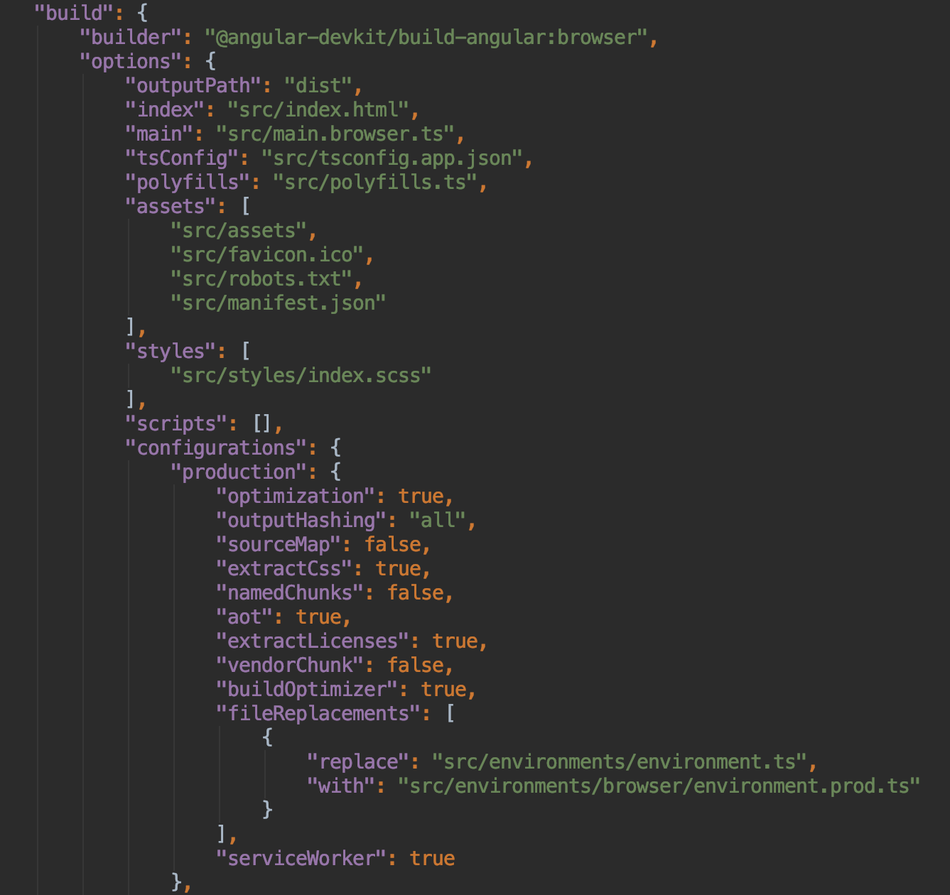
Angular configuration

Slide 5
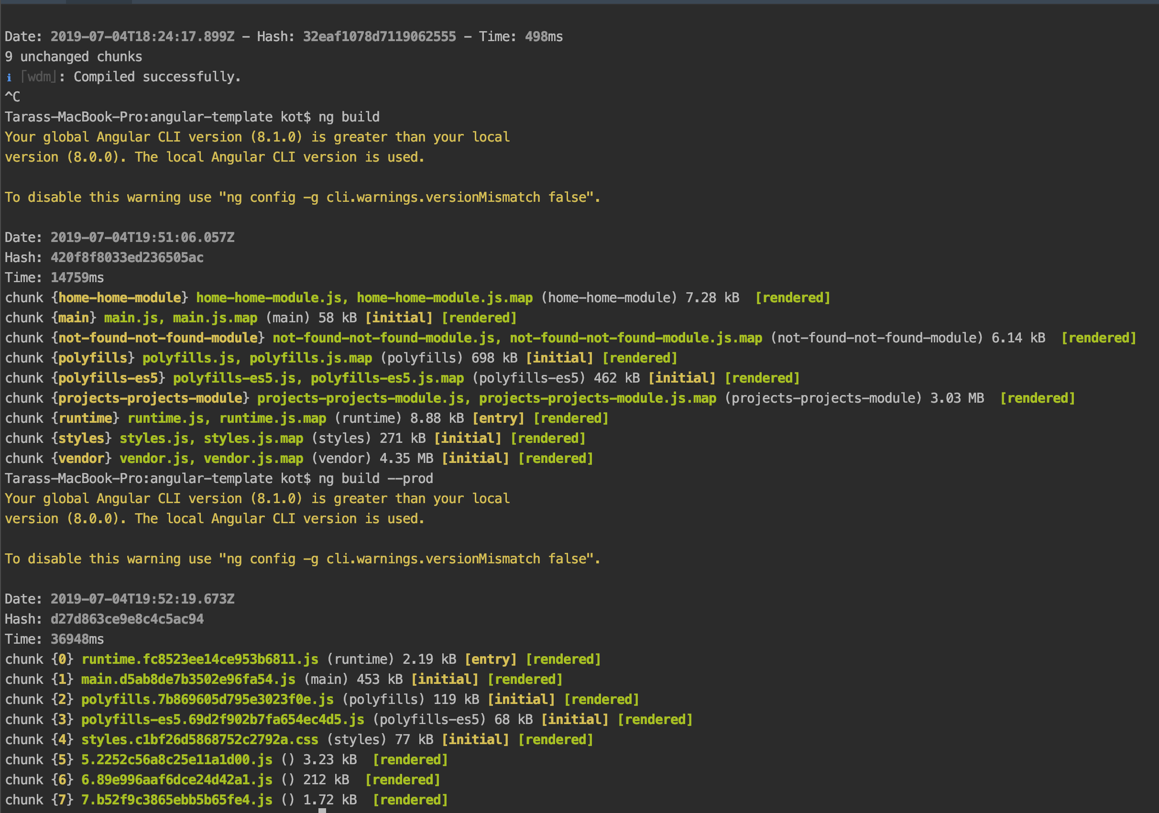
Angular Production build

Slide 6
Continuous delivery
Docker
Hosting
Error handling

Slide 7
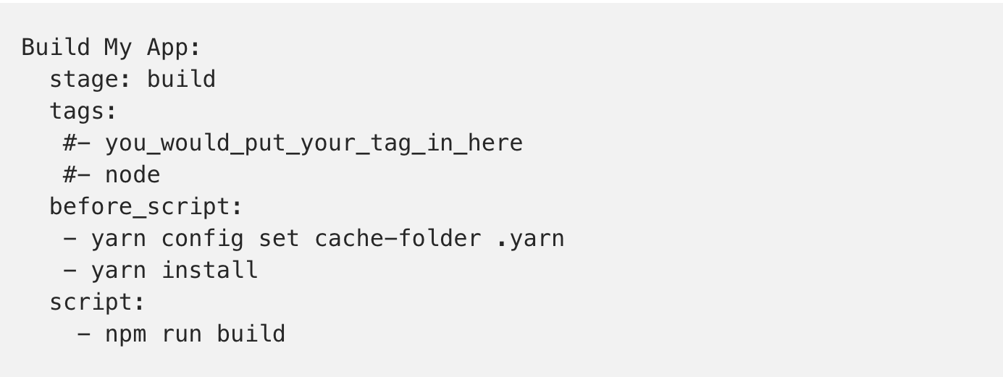
CI Gitlab

Slide 8

Thank you!

